Slide 1

Sentiment Analysis
Marketing analysis
Project - 5

Slide 2

TEAM MEMBERS – 08
Dharmik Patel
Manav Patel
Nimesh Prajapati
Mayur Parmar
Deep Chaudhary

Slide 3

Agenda​
Introduction
Data visualizations
Insights and Recommendations
Machine Learning Models
Summary

Slide 4
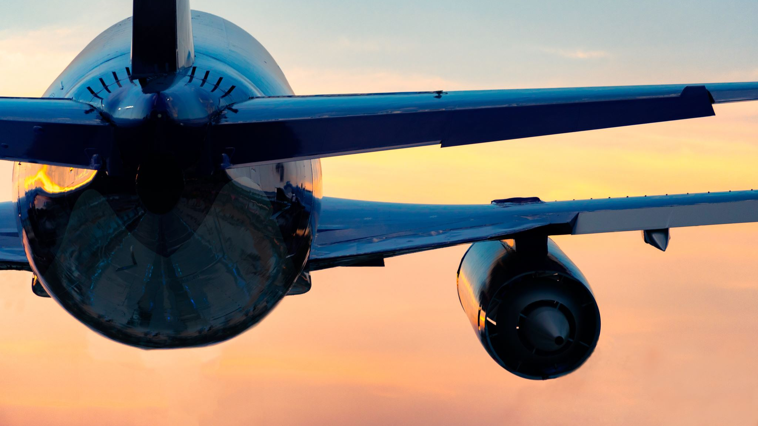
Introduction​
This information is about tweets on Twitter where people talk about their experiences with airlines. It includes details like the tweet ID, how the person feels about the airline (whether they are happy, sad, etc.), how confident they are about their feelings, why they might be unhappy, the name of the airline, how many times the tweet has been shared, what the tweet says, and details about the person who wrote it.
The main goal is to use computer programs that understand language (NLP) to figure out how people feel about different airlines. By doing this, we hope to find patterns and understand what makes customers happy or unhappy. This information can be helpful for airlines to improve their services and make customers happier.

Slide 5
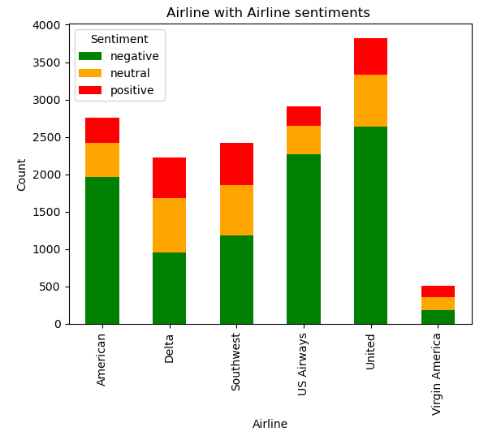
DATA VISULIZATION
INSIGHTS
Most customers seem unhappy, with negative sentiments dominating across all airlines. United Airlines stands out with the most unfavorable tweets, suggesting higher dissatisfaction compared to other airlines. On the flip side, Virgin America has the least number of unfavorable tweets among the companies, possibly indicating higher customer satisfaction.
RECOMMENDATION
Improve Customer Service: Look into unfavourable opinions, particularly regarding airlines like United, in order to pinpoint and fix problem areas.
Engage with clients on social media in a proactive manner, especially if they are voicing dissatisfaction.
Profit from favourable Comments: Airlines that receive a lot of favourable feedback should examine pleasant experiences and use them to their marketing plans.

Slide 6
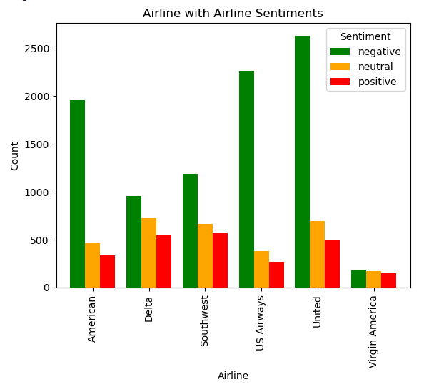
Insights:
Significant consumer unhappiness is shown by a noticeable increase in unfavourable tweets, which distinguishes United and US Airways.
Different airline counts of unfavourable tweets show a vast variation in the level of service that customers perceive.
Different airline counts of unfavourable tweets show a vast variation in the level of service that customers perceive.
RECOMMENDATION
Focus of Analysis: Examine unfavourable tweets about US Airways and United in-depth, paying particular attention to recurring problems with luggage handling, aircraft delays, and customer service.
Improvement of Services Priority: Give customer service enhancements, such as employee training and faster reaction times, a priority for airlines that have more negative customer feedback.

Slide 7
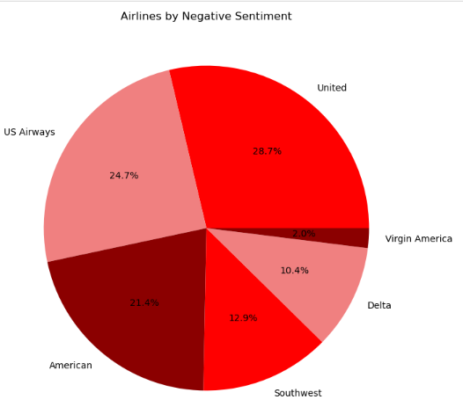
Insights:
We can see from the pie chart Airlines by negative sentiment, UK has the highest which is 28.7% while US airways around 24.7%.These two both cover almost half airways sentiment.
Virgin America has the lowest 2.0% which is the lowest amongst all of them.
Recommendation:
Work on making unhappy customers happier by fixing specific services they didn't like, and talk to them to show you care and want to make things better.
Ask customers for feedback, check what other airlines are doing well, and share stories of happy customers to improve how you talk to people and solve their problems in your airline project.

Slide 8
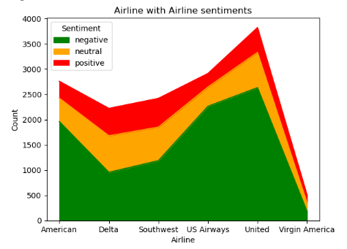
Insights:
During Airline negative, neutral and positive sentiment, can see that all the sentiments graphs united has the highest while Virgin America has negative all of them.
Comparing between sentiments positive sentiment count high and negative count is the lowest all of them.
Recommendation:
Help United Airlines get better by fixing the things that make customers unhappy. Also, figure out why Virgin America is not doing well and improve their services.
Share happy stories from customers in your ads and learn from other airlines that customers like to make your airline better.
Listen to customers when they're not happy, talk to them to fix things, and let everyone know how you're making things better in your marketing.

Slide 9
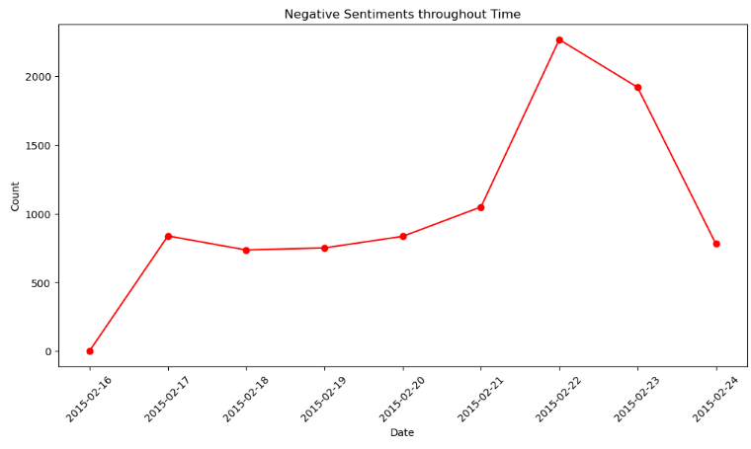
Insights:
Count of negative sentiment throughout time graph initially it was its lowest lowest value while it is increased and sustained between 500 and 1000 till year of 2021.
After that it was suddenly increased and touch the pic year of 2023 and then went down in year of 2024.
Recommendation:
Analyze and tackle the factors causing a sustained level of negative sentiments between 500 and 1000 until 2021 to improve overall customer satisfaction.
Investigate the sudden increase in negative sentiments in 2023 to identify specific events or issues that triggered the spike and address them promptly.
Capitalize on the decline in negative sentiments in 2024 by reinforcing positive changes and communicating improvements to sustain customer satisfaction over time.

Slide 10
Final Thoughts
Studying how people feel about airlines is really helpful for the companies. It lets them understand what customers think, find areas to improve, and make passengers happier overall. In the tough competition among airlines, having a good reputation relies on keeping an eye on customer opinions and making smart decisions based on how people feel.
Looking closely at what customers say helps airlines not just know if they're generally liked or not, but also why. It's like a tool that lets them see the specific things that make customers happy or unhappy. This detailed understanding helps airlines make their services better, fix any problems, and respond well to what customers want, building a positive connection between the airline and its passengers.
In the fast-changing world of airlines, where what people like can change, studying sentiments is like having a guide. It's not just about knowing how customers feel now; it helps airlines look ahead and adapt to what customers will want in the future. So, sentiment analysis is a key part of airlines' efforts to stay in tune with customer feelings and stay ahead in the competition.

